Slide 1

Binary Classification of Populist Speech
Alessandro Pala
Lorenzo Cino
Greta Grelli
Alberto Calabrese
Giacomo Filippin

Slide 2
Abstract
Classification of speeches as populist or non-populist using fine-tuned pre-trained language models.
Models evaluated:
BERT-tiny
BERT-large
GPT-2
RoBERTa-large
Alessandro Pala

Slide 3
Populism
Populism in political speech: Identifying deceitful media.
Definition of populist speech: society split into "the pure people" vs "the corrupt elite".
Politics as the expression of the people's will.
Lorenzo Cino

Slide 4
Populism
<< Modern Socialism is, in its essence, the direct product of the recognition, on the one hand, of the class antagonisms existing in the society of today between proprietors and non-proprietors, between capitalists and wage-workers; on the other hand, of the anarchy existing in production. Like every new theory, modern Socialism had, at first, to connect itself with the intellectual stock-in-trade ready to its hand, however deeply its roots lay in material economic facts. >> Socialism: Utopian and Scientific, Friedrich Engels
<< We win when we are united. Democracy is about one person, one vote. It's about all of us coming together to determine the future of our country. It is not about a handful of billionaires buying elections, or governors suppressing the vote by denying poor people or people of color the right to vote. >> Our Revolution: A Future to Believe In, Bernie Sanders
Lorenzo Cino

Slide 5




Dataset
500 speeches: 250 populist, 250 non-populist.
Data format: .xlsx file with speeches and labels.
Data sources: Digital repositories, newspaper transcripts, academic material.
Language diversity: peeches translated using deep learning models.
Alessandro Pala

Slide 6
Methodology - Preprocessing
Dataset split: 80-20 (training-testing).
Tokenization: Using model-specific tokenizers.
Attention masks for token differentiation.
Data loaders for batching and shuffling.
Custom sequence classification with dropout layer.
Alessandro Pala

Slide 7
Methodology - Model Fine-Tuning
Models: BERT-tiny, BERT-large, GPT-2, RoBERTa-large.
Training with Adam optimizer, dynamic learning rate.
Gradient clipping to prevent exploding gradients.
Batch sizes adjusted to avoid GPU memory overload.
Alessandro Pala

Slide 8
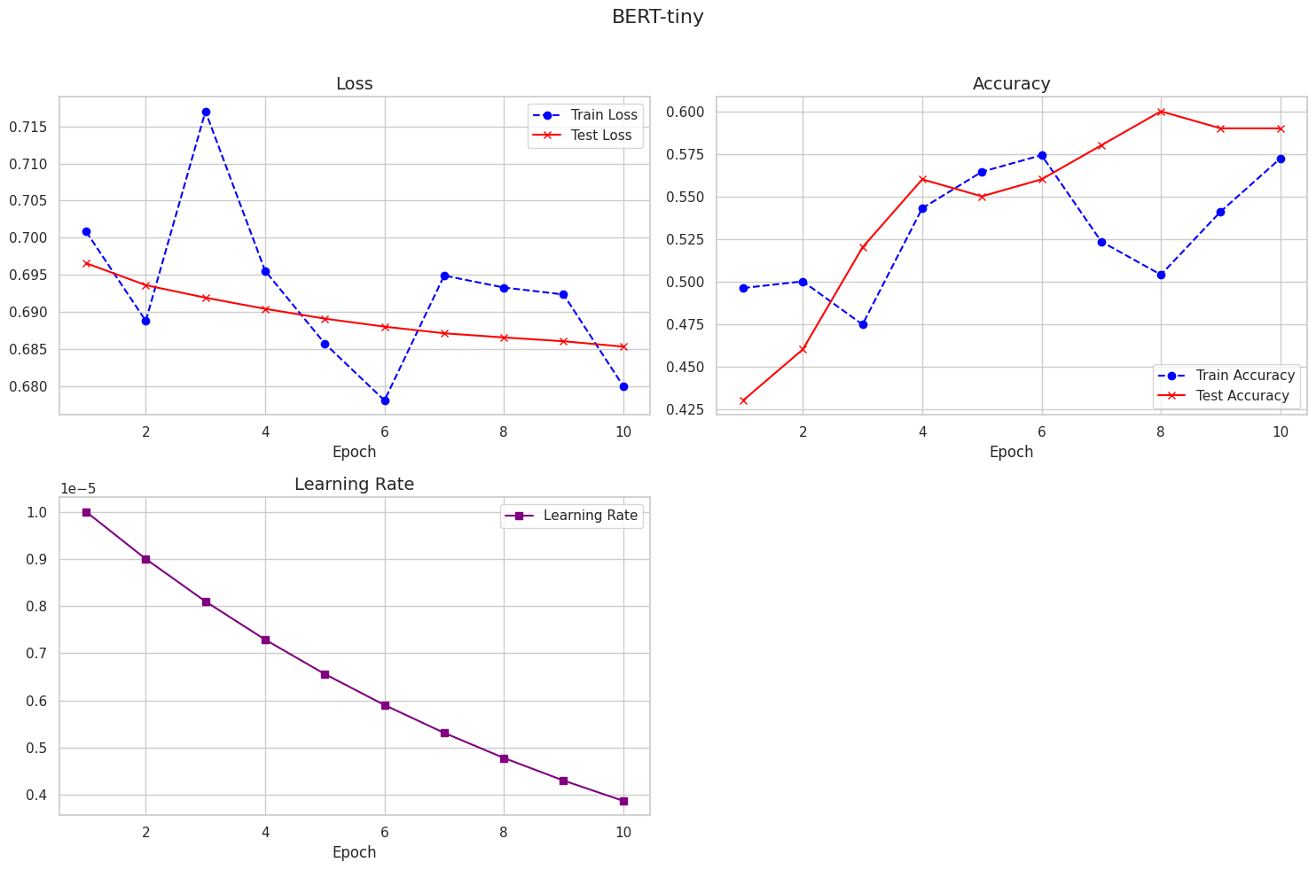
Model Performances - BERT-tiny
Training epochs: 10
Accuracy slightly above random
Noisy performance trends.
Alberto Calabrese

Slide 9
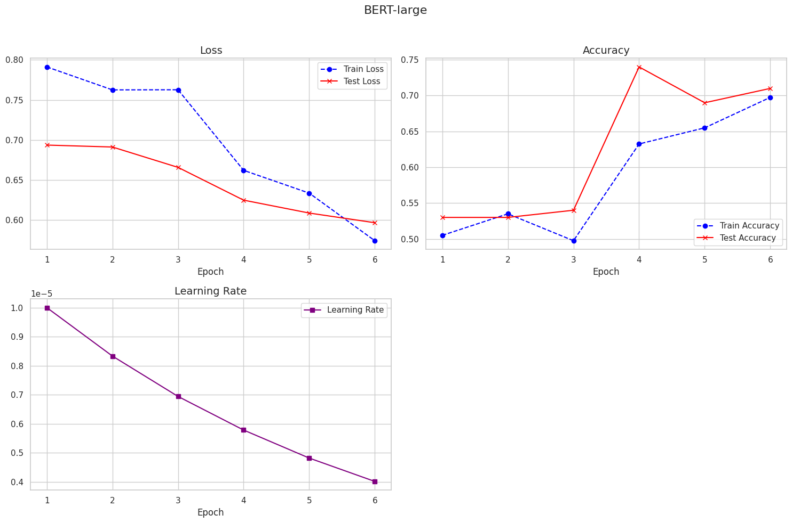
Model Performances - BERT-large
Training epochs: 6
Loss: Approximately 0.57
Accuracy: About 0.71
Improved performance but plateaued.
Lorenzo Cino

Slide 10
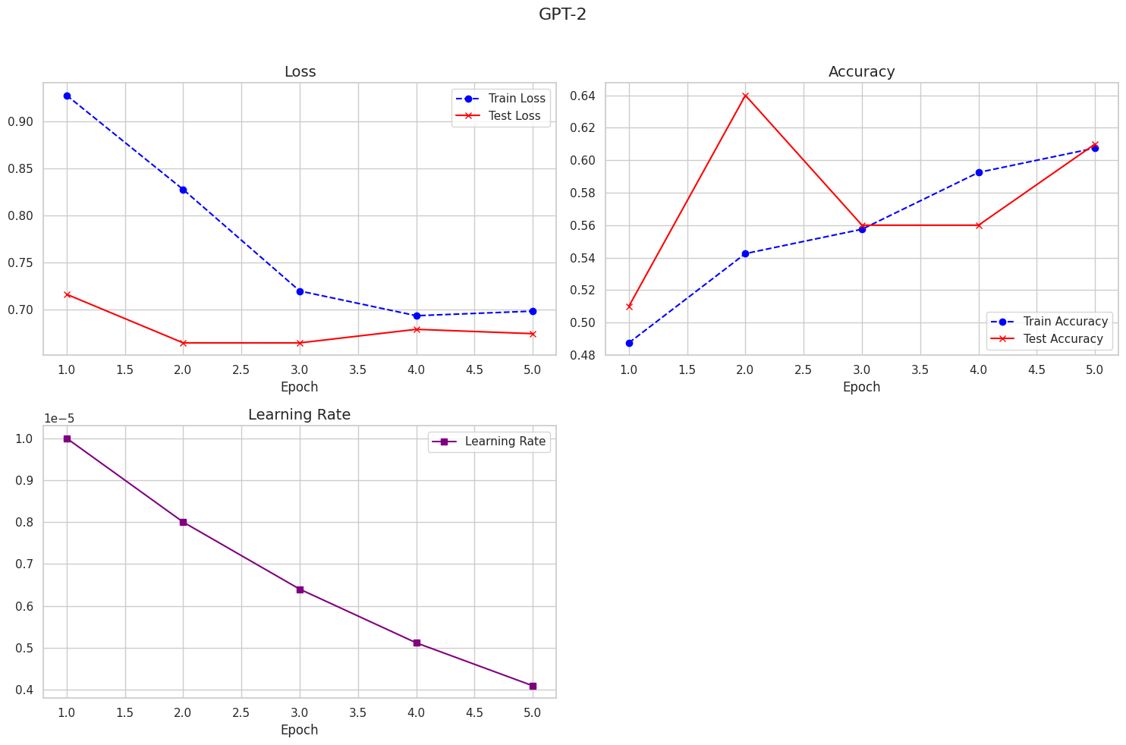
Model Performances - GPT-2
Training epochs: 5
Loss: Slight improvement, 0.67
Accuracy: Noisy, between 0.50 and 0.64
Struggles with text classification tasks.
Giacomo Filippin

Slide 11
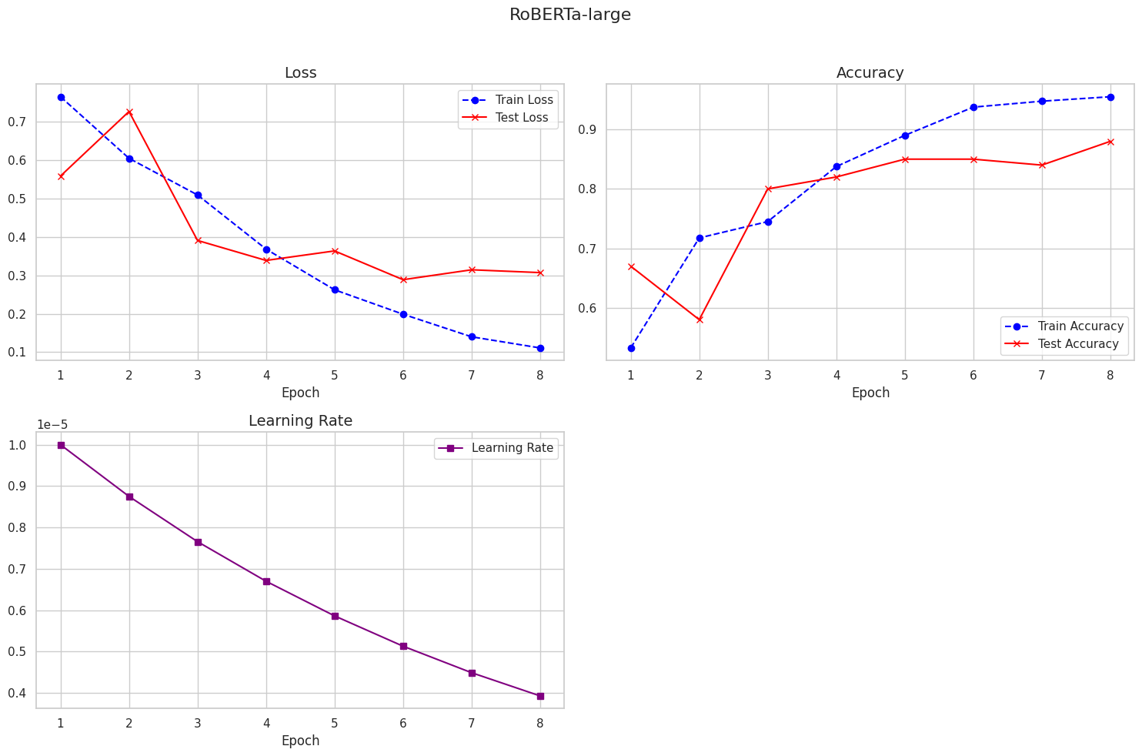
Model Performances - RoBERTa-large
Training epochs: 8
Loss: 0.2
Accuracy: 0.88
Best performing model.
Greta Grelli

Slide 12
Conclusion
RoBERTa-large is the most effective model with 88% accuracy.
Encoder-only models are suitable for binary classification tasks.
Future work: Expand dataset size, explore alternative model structures, train models to assign varying levels of populism.

Slide 13





Greta
Alessandro
THANK YOU
Giacomo
Alberto
Lorenzo

